Slide 1
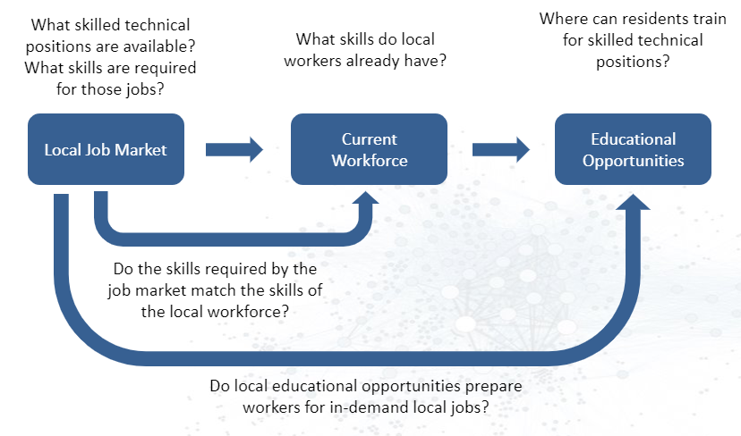

Measuring the Skilled Technical Workforce
Alyssa Fowers (Miami University), Calvin Isch (Indiana University), Sarah McDonald (Marymount University)
Vicki Lancaster, Sam Cohen, (SDAD)
Social & Decision Analytics Division
Problem Data Metrics MSA
Subhead - Franklin Gothic Demi - 28
Reference Text - Franklin Gothic Book - 18
References - Franklin Gothic Demi - 24
Critical Care Nurses
Blacksburg vs Richmond Skills
Hard/Soft Skills Breakdown
Education – where to get those skills
Bachelors vs No bachelors
Mismatch
Highly Requested vs Highly Provided Skills
Conclusions

